Slide 1
Data Visualization of Bird Strikes
BY Sanjit Cyrus R

Slide 2
Introduction
Bird strikes pose a significant risk to aviation safety worldwide, with the potential to cause damage to aircraft and endanger passengers and crew. In this presentation, we will explore the data surrounding bird strikes, analyze trends and patterns, and discuss strategies for mitigating this critical safety concern using innovative data visualization techniques.
Bird strikes represent a complex and multifaceted challenge for the aviation industry. Understanding the frequency, location, and contributing factors of bird strikes is essential for developing effective prevention and mitigation strategies. By visualizing bird strike data, we can identify high-risk areas, recognize seasonal trends, and inform decision-making processes to enhance aviation safety.

Slide 3
ObjectiveS
To visualize hidden trends of bird strikes.
To analyse the cost of these bird strikes
To analyse the effect of bird strikes with different factors

Slide 4
Proposed methodlogy
We use Microsoft power BI to visualize trends and patterns in the data. Microsoft Power BI is a business analytics tool that transforms raw data into insightful visualizations for informed decision-making.
We use four pages of report to visualize the trends and patterns.
The first three pages focus on the effect of factors on the number of bird strikes.
The last page focuses on effect indicators.
After seeing the information about the dataset we would explore the report page by page.

Slide 5
Information about dataset
The data set has data on bird strikes in the USA collected from FAA from 2000 to 2011.
The data set has more than 25,000 columns and 26 columns. The columns are listed below.
Record ID, Aircraft: Type, Airport: Name, Altitude bin, Aircraft: Make/Model, Wildlife: Number struck, Wildlife: Number Struck Actual, Effect: Impact to flight, FlightDate, Effect: Indicated Damage, Aircraft: Number of engines?, Aircraft: Airline/Operator, Origin State, When: Phase of flight, Conditions: Precipitation, Remains of wildlife collected?, Remains of wildlife sent to Smithsonian, Remarks, Wildlife: Size, Conditions: Sky, Wildlife: Species, Pilot warned of birds or wildlife?, Cost: Total $, Feet above ground, Number of people injured, Is Aircraft Large?

Slide 6



Bird Strike Visuals
View in Power BI
Last data refresh:
4/15/2024 10:00:10 AM UTC
Downloaded at:
4/15/2024 10:08:47 AM UTC

Slide 7
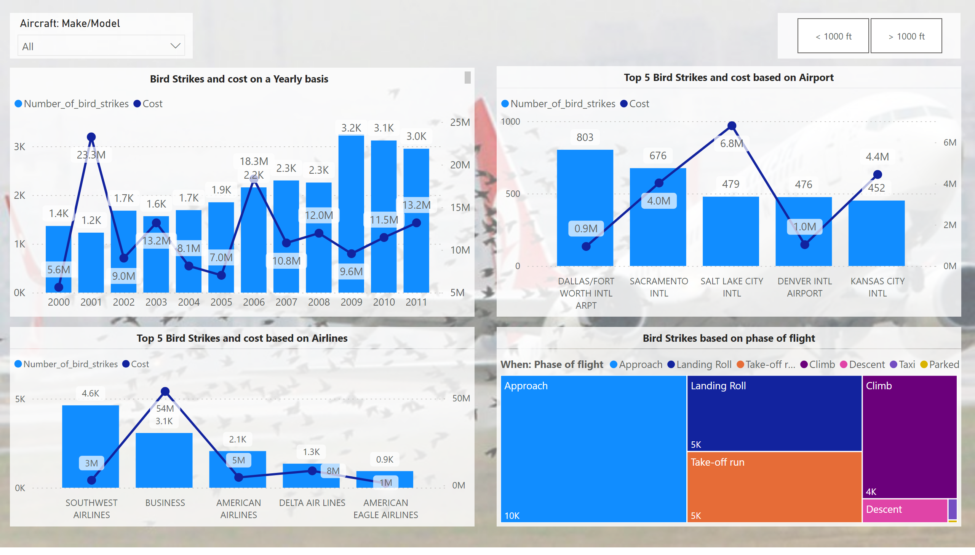
Number of Bird strikes - 1
Notes:
lineStackedColumnComboChart
No alt text provided
lineStackedColumnComboChart
No alt text provided
slicer
No alt text provided
treemap
No alt text provided
lineStackedColumnComboChart
No alt text provided
slicer
No alt text provided
textbox
No alt text provided
textbox
No alt text provided
textbox
No alt text provided
textbox
No alt text provided

Slide 8
Insights from number of bird strikes -1
The highest number of bird strikes happened in the year 2009.
The highest cost due to the number of bird strikes is in the year 2001.
Most bird strikes have happened in Dallas/Forthworth International Airport.
The highest cost by airport is Salt lake city international Airport.
Southwest airlines airplanes has the highest number of bird strikes.
Business airlines has incurred the highest cost due to bird strikes.
Most bird strikes happen during Approach phase.

Slide 9
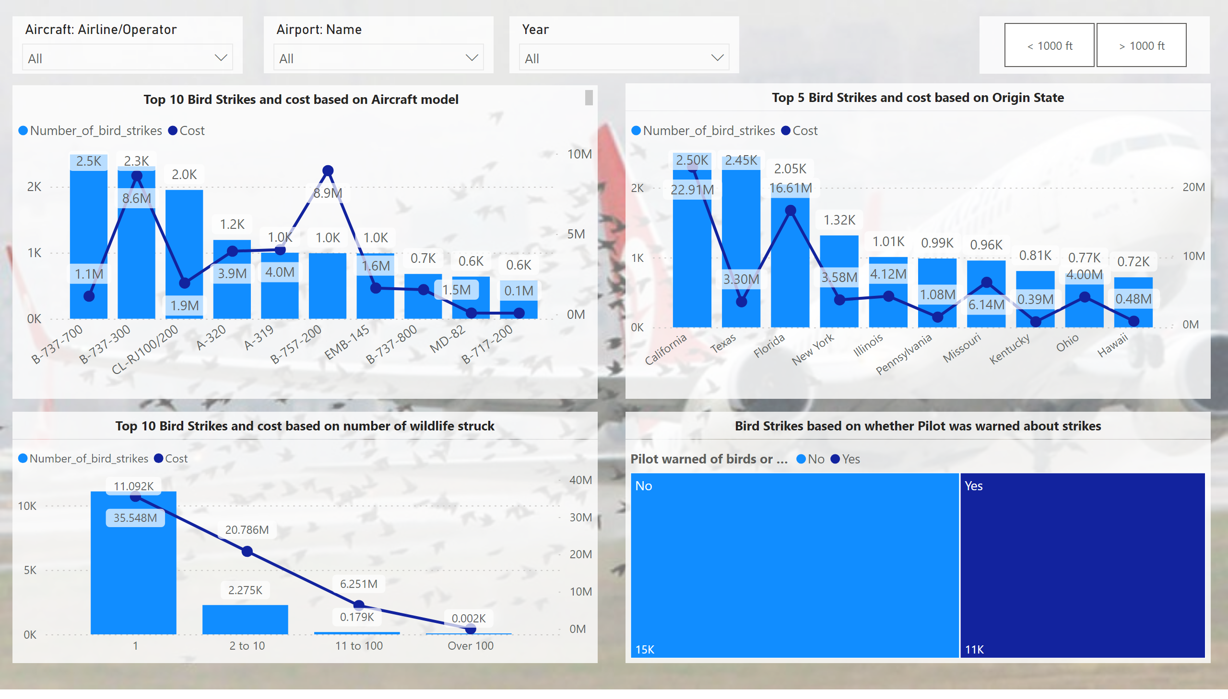
Number of Bird strikes - 2
Notes:
lineStackedColumnComboChart
No alt text provided
lineStackedColumnComboChart
No alt text provided
slicer
No alt text provided
treemap
No alt text provided
lineStackedColumnComboChart
No alt text provided
slicer
No alt text provided
textbox
No alt text provided
textbox
No alt text provided
textbox
No alt text provided
textbox
No alt text provided
slicer
No alt text provided

Slide 10
Insights from number of bird strikes -2
B -737 – 700 is the airplane that has been stuck the most number of times by lightning.
B – 757 – 700 is the airplane that need the highest cost due to bird strike.
California state tops number of bird strikes and the cost due to them.
Mostly only one wildlife has struck the airplane.
Atleast for 57 % of the times the bird strikes were not informed prior to the incident to the pilot. So this indicates that bird strikes can happen unexpectedly.

Slide 11
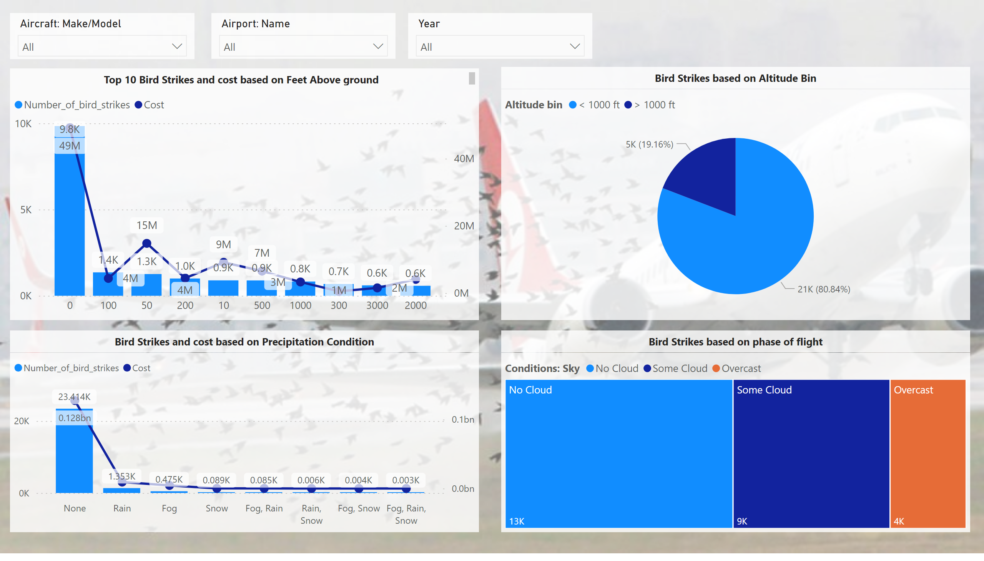
Number of Bird strikes - 3
Notes:
lineStackedColumnComboChart
No alt text provided
slicer
No alt text provided
treemap
No alt text provided
lineStackedColumnComboChart
No alt text provided
textbox
No alt text provided
textbox
No alt text provided
textbox
No alt text provided
textbox
No alt text provided
pieChart
No alt text provided
slicer
No alt text provided
slicer
No alt text provided

Slide 12
Insights from number of bird strikes -3
Most of the bird strikes happen on ground and at an altitude less that 1000 ft.
Most bird strikes occur when there is no precipitation and cloud

Slide 13
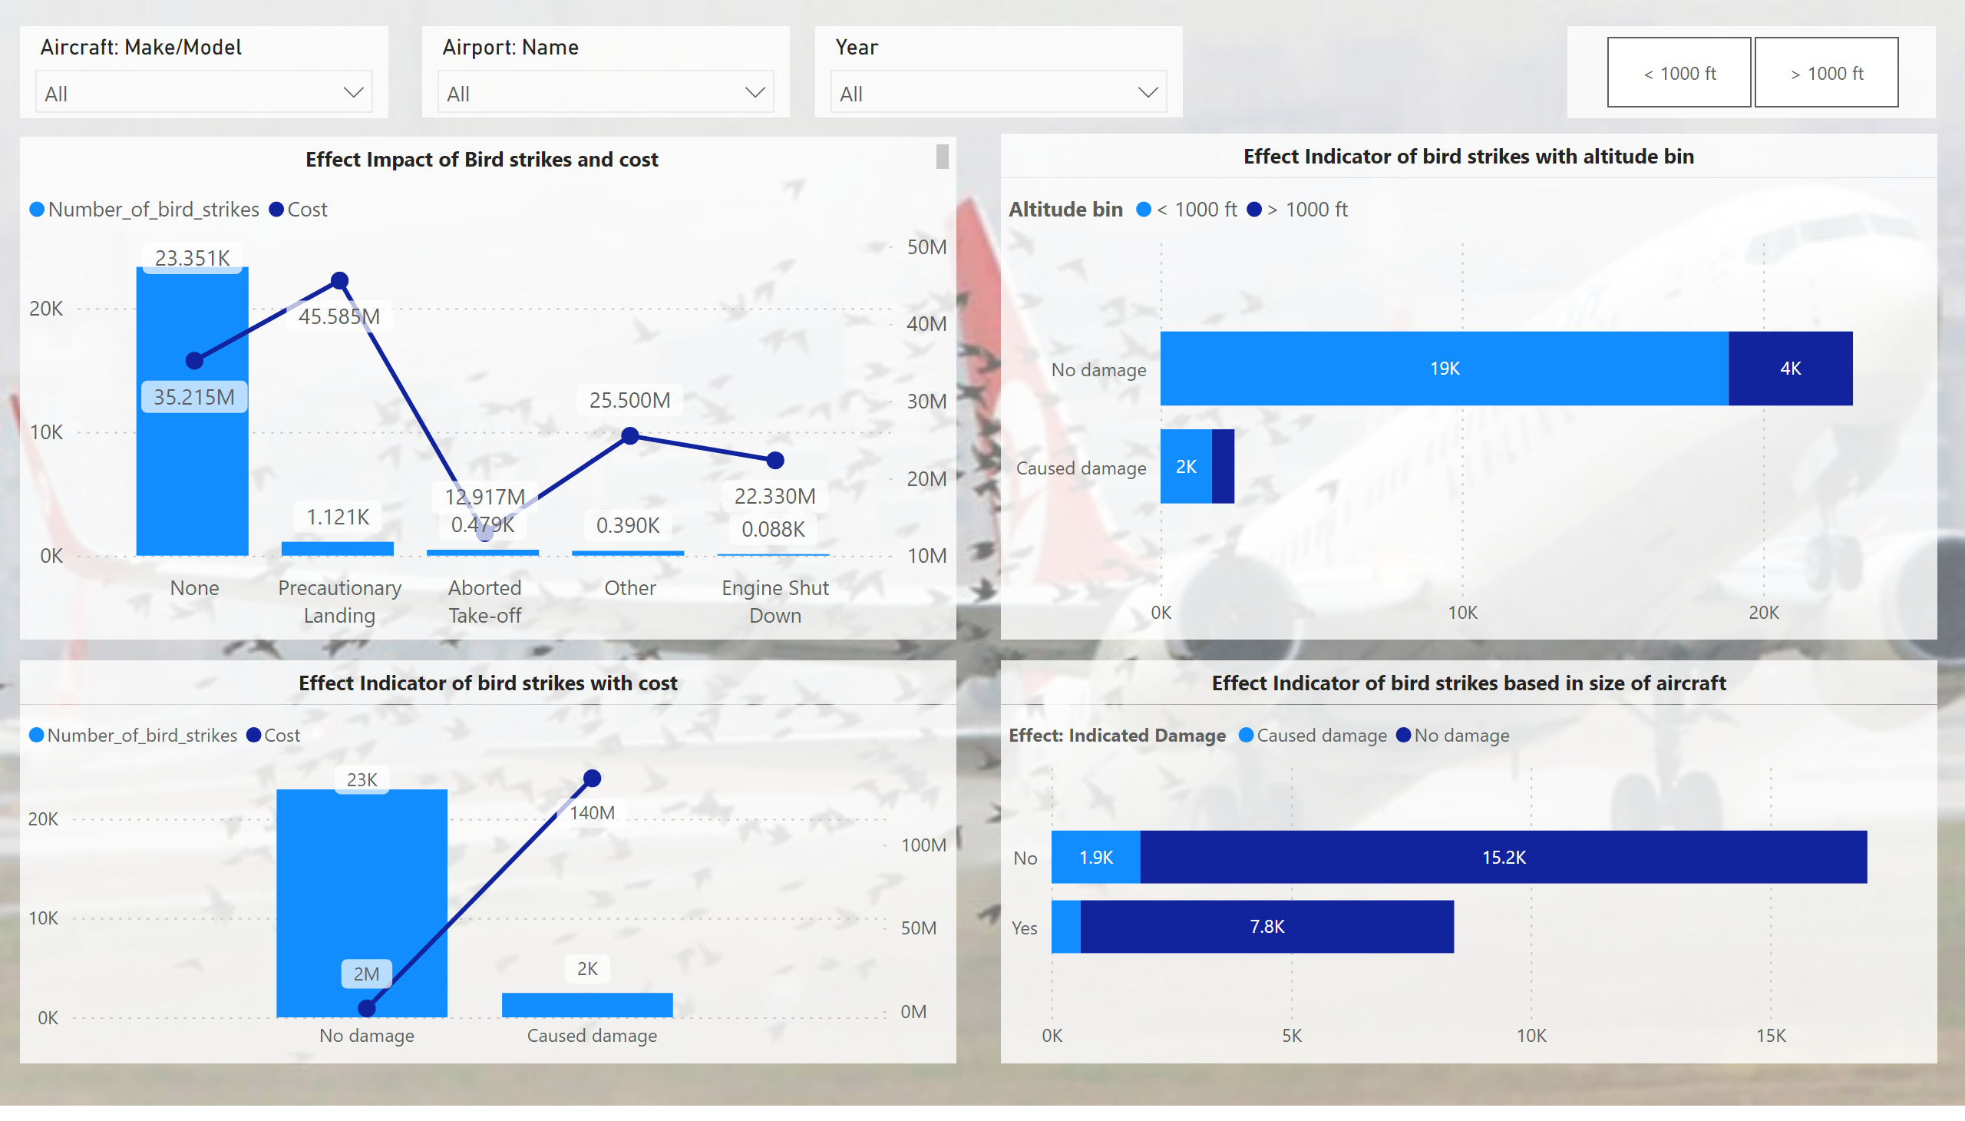
Effect of Bird strikes - 1
Notes:
lineStackedColumnComboChart
No alt text provided
slicer
No alt text provided
barChart
No alt text provided
lineStackedColumnComboChart
No alt text provided
slicer
No alt text provided
textbox
No alt text provided
textbox
No alt text provided
textbox
No alt text provided
textbox
No alt text provided
barChart
No alt text provided
slicer
No alt text provided
slicer
No alt text provided

Slide 14
Insights from effect of bird strikes -1
Most of the bird strikes doesn’t cause a impact on the flight but there are incident where bird strike cause a major impact that causes precautionary landing and this costs more.
Most of the bird strikes cause little to no harm to the aircrafts.
The bird strikes are more in smaller airplanes.
Bird strikes when they cause damage cost more.

Slide 15
insights
The Bird strike doesn’t happen during precipitation because birds look for shade during precipitation.
Most birds fly at an altitude less than 1000 ft this is because we see most bird strikes below 1000 ft.
California, Texas state top the highest number of bird strikes. This is due the high number of wildlife present in those states.
Eventhough the bird strike happen unexpectedly, the number of bird strikes can be reduced if there are sufficient warning systems.
Most bird strikes happen during approach phase so pilots need to be cautious during that phase

Slide 16
Conclusion
A basic data visualization of the bird strikes are seen in the previous slide.
With the available data even more reports can be created and insights be generated.
More questions could be answered.

Slide 17
Thank you
Sanjit Cyrus R
sanjitcyrus007@gmail.com
https://www.linkedin.com/in/sanjit-cyrus/

